Slide 1


Energy Efficiency: Buildings Retrofit
Maynooth University
Trainee: Pietro Luigi Desole

Slide 2
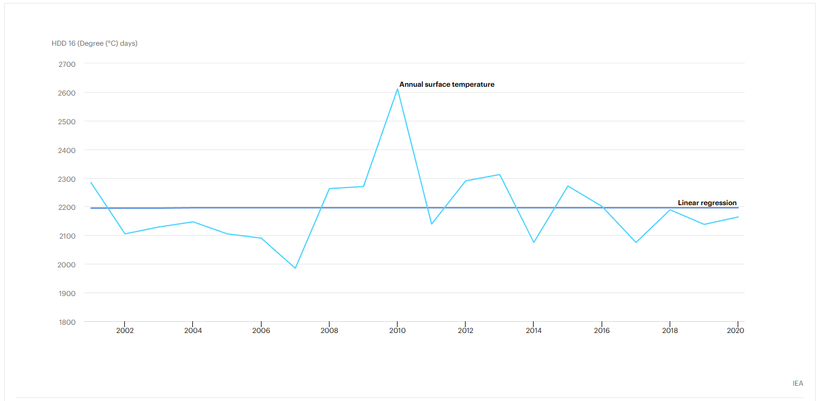
City Climate: Heating Degree Days
Source :
IEA, Heating degree days in Ireland, 2000-2020, IEA, Paris https://www.iea.org/data-and-statistics/charts/heating-degree-days-in-ireland-2000-2020, IEA. Licence: CC BY 4.0 (HDD Ireland)

Slide 3
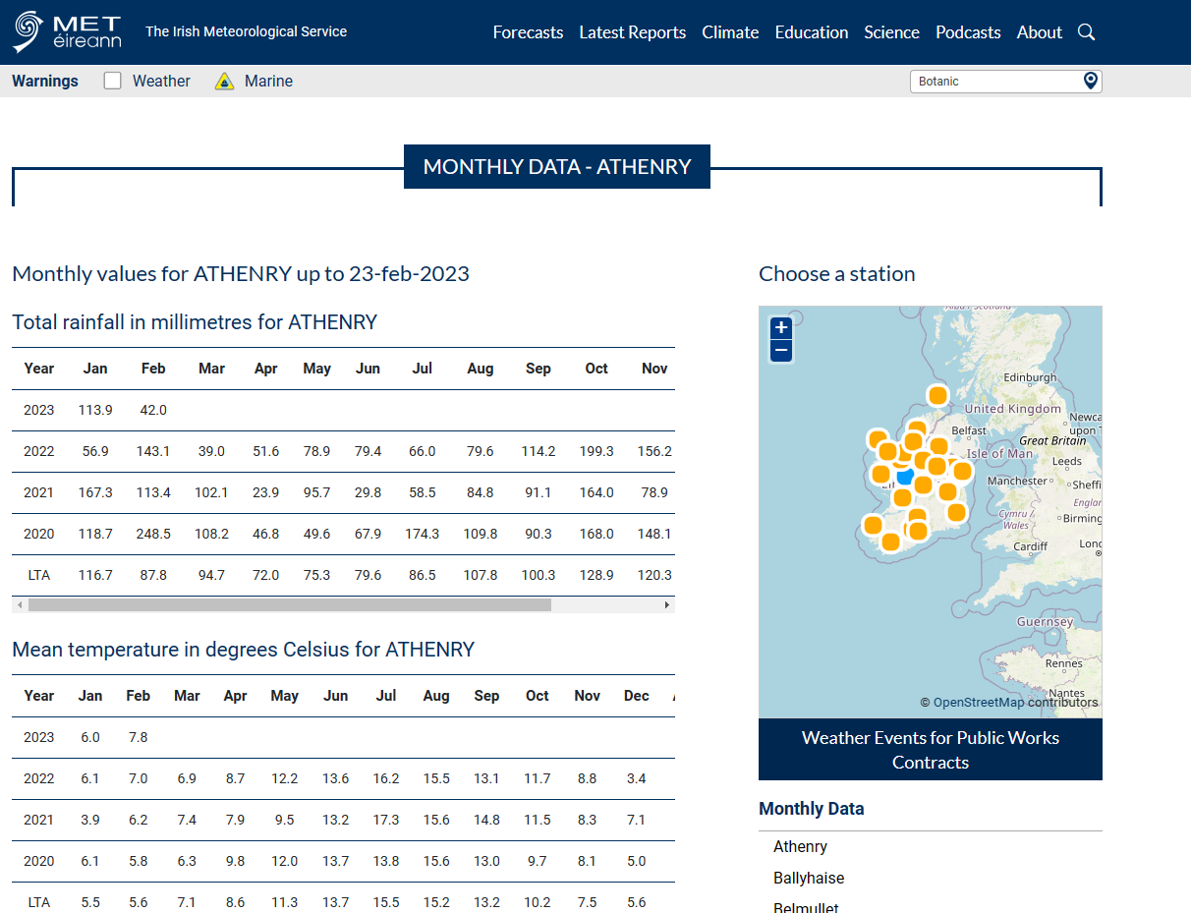
City Climate: Average Temperature & Degree Days
Datasets from meteorological Stations across Ireland.
Source:
Monthly Data - Met Éireann - The Irish Meteorological Service

Slide 4
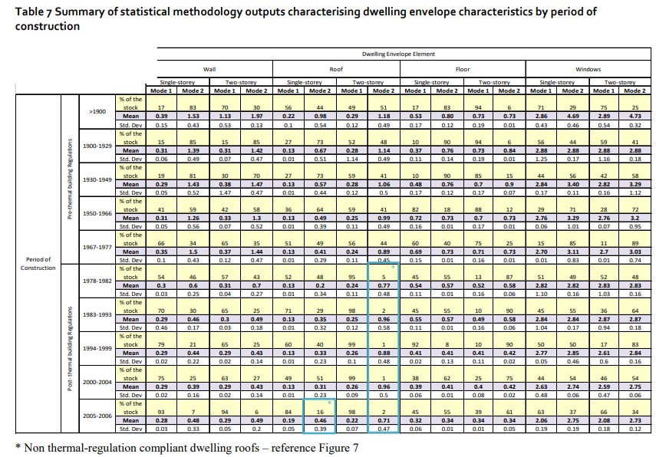
Irish Thermal Data: Age – Wall/Roof/Floor Transmittance
Average Thermal Data of existing detached dwellings and multistorey buildings classified by the year of construction.
Source:
AHERN, Ciara; NORTON, Brian. Thermal energy refurbishment status of the Irish housing stock. Energy and Buildings, 2019, 202: 109348.

Slide 5
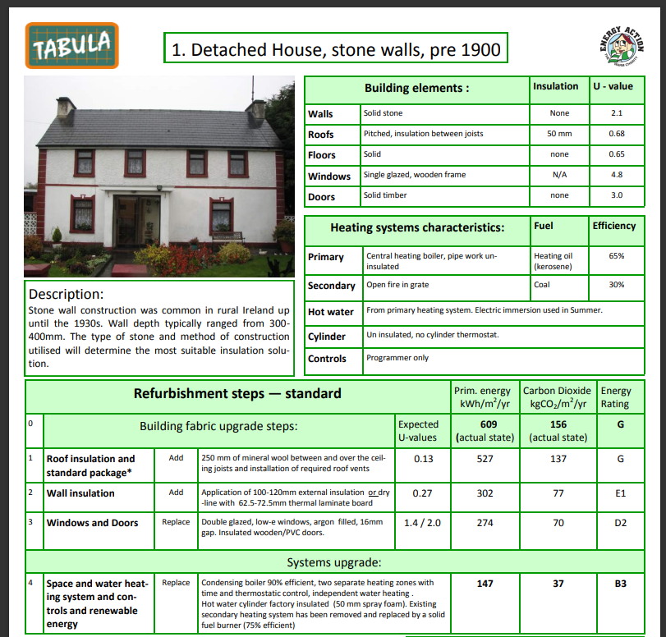
Irish Thermal Data: Age – Wall/Roof/Floor Transmittance
Average Thermal Data of existing detached dwellings and multistorey buildings classified by the year of construction.
Source:
TABULA report https://episcope.eu/fileadmin/tabula/public/docs/brochure/IE_TABULA_TypologyBrochure_EnergyAction.pdf

Slide 6
Thermal Data: Dispersion Surface/Volume
Assumptions:
Houses to be a perfect parallelepiped;
One side of the house is the 2/3 of the other;
The Formula then Rebuild to match available data: S/V = (FA*h)/[FA+(2h*(S1+S2)]
Where S1 will be 2/3 of S2 and FA = S1*S2.
The data needed become then only average Floor Area (FA) and average height (h)
Source: Domestic Building Energy Ratings Quarter 1 2023 - CSO - Central Statistics Office
(TAB. 12)

Slide 7

Thermal Data: Window Surfaces/Floor Area
This particular data is taken from a policy emitted in 2010 on planning and building unit with a range of ratios window surface must have in comparison of the floor area of the buildings, including thermal transmittance policy, too.

Slide 8
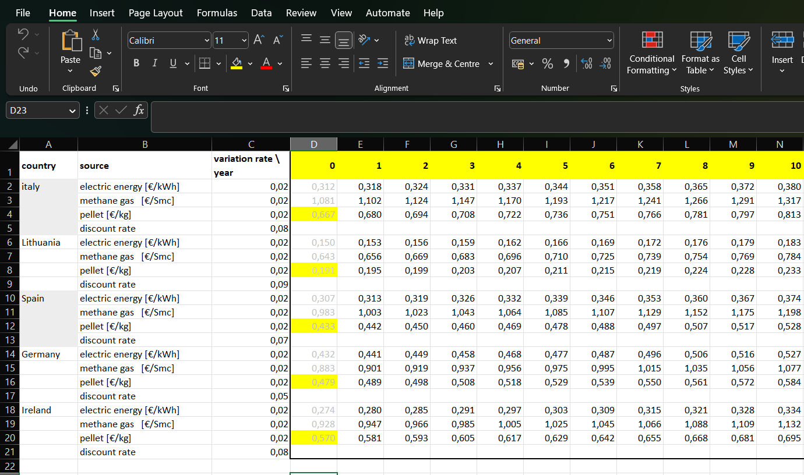
Variable Cost
Electricity Prices : https://ec.europa.eu/eurostat/statistics-explained/index.php?title=Electricity_price_statistics ;
Methane (natural Gas) Prices Euro/kWh : https://ec.europa.eu/eurostat/statistics-explained/index.php?title=Natural_gas_price_statistics [10,96 kWh/smc]
Price pellet Italy : https://quifinanza.it/green/crisi-del-gas-e-caccia-al-pellet-ma-e-sostenibile/664431/#:~:text=Il%20costo%20del%20sacco%20da%2015%20kg%20di,del%202021-2022.%20Costi%20alle%20stelle%20per%20il%20pellet
Price Pellet Germany : https://www.fordaq.com/news/German_pellet_price_in_June_76638.html#:~:text=A%20high%20demand%20paired%20with%20high%20production%20costs,month%20and%2095%25%20more%20than%20in%20June%202021
Price Pellet Spain (and France) : https://www.infoiva.com/2022/10/prezzo-pellet-ecco-quanto-costa-realmente-in-francia-e-spagna.html
Price Pellet Lithuany : https://pellets-wood.com/wood-pellets-from-lithuania-o23144.html
Price Pellet Ireland : https://www.seai.ie/publications/Domestic-Fuel-Cost-Comparison.pdf

Slide 9

Thank you!
By Pietro Luigi Desole

